Slide 1
STUDENT NAME: VARUN KUMAR.R REGISTER NO AND NMID: 24bca146
&EB391FAFF6F986AAFA647458E4027502
DEPARTMENT: B.C.A Computer Application COLLEGE: Mohamed Sathak College of Arts and Science

Slide 2
PROJECT TITLE
DIGITAL
PORTFOLIO

Slide 3



AGENDA
Problem Statement
Project Overview
End Users
Tools and Technologies 5.Portfolio designand
Layout
Features and Functionality
Results andScreenshots
Conclusion
Github Link
3/21/2024Annual Review
1

Slide 4


PROBLEM STATEMENT
In today’s competitive digital world, individuals lack a centralized, professional, and visually
appealing platform to showcase their academic achievements, skills, and projects.
A digital portfolio is necessary to present
personal and professional information effectively.

Slide 5

PROJECT OVERVIEW
TheDigital Portfolio Websiteis a personal platform designed to highlight academic, technical, and creative skills.
It contains sections such as About Me, Education,
Projects, Skills, Certifications, and Contact information.
The website is responsive, user-friendly, and customizable.

Slide 6
WHO ARE THE END USERS?
Students – Showcase academic achievements and skills Job Seekers – Highlight projects and certifications Professionals – Build an online personal brand Recruiters/Employers – View candidate portfolios easily

Slide 7


TOOLS AND TECHNIQUES
Frontend: HTML, CSS,JavaScript, Bootstrap
Backend: Python (Flask/Django) or PHP (if required)
Database: MySQL / SQLite (optional)
Hosting: GitHub Pages / Netlify Version Control: Git & GitHub

Slide 8

POTFOLIO DESIGN AND LAYOUT
The design follows a clean, minimal, and
professionallayoutwith proper
navigation. Sections include:Home,
About,
Projects, Contact.
Skills,
Education, Certifications, and
The portfolio is responsivefor
both
desktop and mobiledevices.

Slide 9
FEATURES AND FUNCTIONALITY
User-friendly interface withsmooth navigation Responsive design for mobile and desktop
Sections for About, Projects, Skills, and Contact Integration with LinkedIn/GitHub Downloadable Resume option

Slide 10
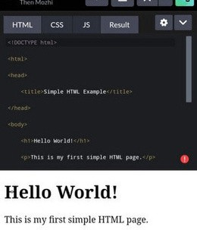
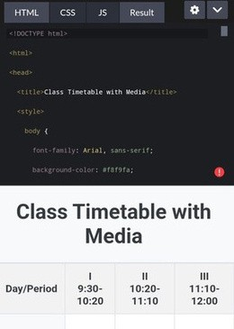

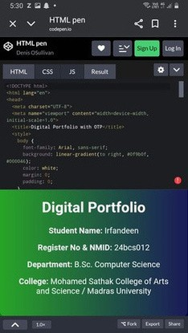
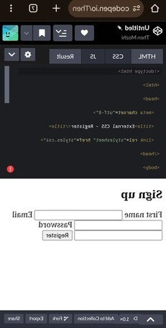
RESULTS AND SCREENSHOTS
3/21/2024Annual Review
10

Slide 11
CONCLUSION
The DigitalPortfolio Website providesan organized and professional wayto
present personalachievements,skills,
and projects.
It enhances careeropportunities and creates a strongdigitalpresence
10

